Slide 1
Uncontrolled copy not subject to amendment
Principles of Flight
Learning Outcome 2
Understand how the stability and manoeuvrability of an aeroplane are controlled
Part 2: Explain how flaps, slats and airbrakes are used by an aircraft during landing
Revision 2.00

Slide 2
High lift devices (flaps) or
Lift augmentation

Slide 3
High lift devices
Objectives:
Describe the principle operation of trailing edge flaps
State the following for trailing edge flaps:
location, effects on lift, effects on drag, types,
advantages and uses
3. Describe the principle operation of leading edge slats
4. State the advantages of slats with reference to
stalling speed, stalling angle and drag
Notes:
Trimming
The weight and the position of an aircraft’s centre of gravity can change in flight, when fuel is used up, bombs dropped, ammunition fired and so on.
The centre of pressure will also change during the flight - usually with alterations of power, speed or attitude. All such changes will affect the balance of forces on the aircraft, sometimes quite markedly. For example a sideways pressure on the stick would be needed to keep the aircraft balanced if fuel is used from the left wing tank quicker than from the one on the right, making the aircraft right-wing heavy. Or on a multi-engined aircraft, should one engine fail or lose power, the differential thrust on the two wings would produce a yawing force which would have to be opposed by constant pressure on a rudder pedal, to maintain direction. In all these conditions, no pilot could fly accurately and safely for long without some help.

Slide 4
High lift devices
Why do we need high lift devices?
High lift devices come in many shapes and forms
They are mounted on the leading and trailing edges of wings
They create more lift at lower speeds to allow lower take-off and landing speeds
The aircraft nose will be lower, allowing a better view for the Pilot
Notes:
How Lift Varies
Several factors affect the amount of lift produced by a wing. Those you need to know about at this stage are:
Airspeed
Altering the airspeed will vary the amount of lift produced by the wings. When an aircraft is stationary before take-off the wings are
producing no lift. However, as the aircraft accelerates along the runway, the lift increases until there is enough to take the weight of the aircraft off the ground. In normal flight the pilot can either use the throttle, or make the aircraft climb or dive to alter the speed of the aircraft through the air. You might think that by doubling the airspeed there would be twice the lift, but in fact lift increases as the square of the speed. Double the airspeed gives four times the lift; treble the airspeed gives nine times the lift, and so on.
b. Angle of Attack
In most flight conditions the wings meet oncoming air at a slight angle which is called the angle of attack. This is the angle between the chord line of the wing and the oncoming air (or path of the aircraft). The chord line is a straight line joining the leading edge to the trailing edge. The pilot can alter the angle of attack by altering the pitch attitude of the aircraft - which the pilot does by easing forward or pulling back on the control column. If the angle of attack is increased steadily from 0° and the airspeed is kept constant, the amount of lift will increase until the angle reaches about 15° If the angle of attack is increased beyond this point, the lift rapidly decreases and the wing is stalled.
c. Air Density
If the air becomes “thinner” or less dense (and this can happen with increases of height, temperature or humidity), the amount of lift is reduced. A low air density will directly concern a pilot, as on take-off the pilot would have to compensate for the reduced lift, by reaching a higher speed than usual to become airborne. This means the pilot would need more runway - and there might not be enough! To calculate the take-off run the pilot would use tables which allow for engine performance, the weight of the aircraft, the wind speed and direction, and of course the air temperature, humidity and density. The pilot might even have to postpone a take-off or alter something to put the aircraft within a safe limit for take-off: for example, off-load some cargo.
d. Wing Shape and Area
The remaining factors that affect the amount of lift produced are the shape of the wing section and the plan area of the wing, both of which have been calculated by the aircraft designer to suit the aircraft’s role and required performance. A high-lift section would be used where good lift at low speeds is all-important - for example on a sailplane.

Slide 5
Methods of lift augmentation
Flaps (trailing edge and leading edge)
Slats and slots
Notes:
METHODS OF LIFT AUGMENTATION
FLAPS (Trailing Edge & Leading Edge)
SLATS & SLOTS
BOUNDARY LAYER CONTROL
(Vectored Thrust)
(Variable Geometry)

Slide 6
Flaps
1. Plain flap
50% increase C_{LMAX} Critical angle 12º
Notes:
LIFT AUGMENTATION DEVICES
How does each increase Cl , camber etc?
For the sake of safety, an aircraft’s wing should be designed so that the aircraft can make its approach to land at a controlled slow speed, and along a moderately steep approach path (so the pilot can see easily over the nose, to where the aircraft is landing).
However, this design of wing will not be efficient at the higher speeds needed for transit and other operational flying. A well-proven solution to the problem is to design the wing largely for its main task, and to add flaps for use on the approach and landing.
How do flaps work?
The flaps are hinged surfaces, usually fitted to the trailing edges of the wings, inboard of the ailerons. They can be mounted along the leading edges - and some aircraft, particularly airliners, have them at both the leading and trailing edges. However, we shall confine ourselves to the trailing edge variety. The flaps, one on each wing, are operated together and in stages by the pilot. In the unused or “up” position they lie flush with the wing surfaces and form part of the wing, and in the fully “down” position they are at an angle of 90° or so to the wing surfaces.
There are many types of flaps, each with their own characteristics, but when selected down they all increase the effective camber of the wing and hence its lift. In addition, flaps will increase drag.

Slide 7
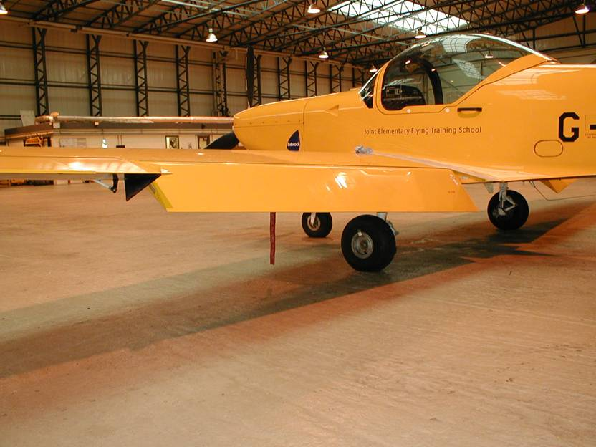

Slide 8
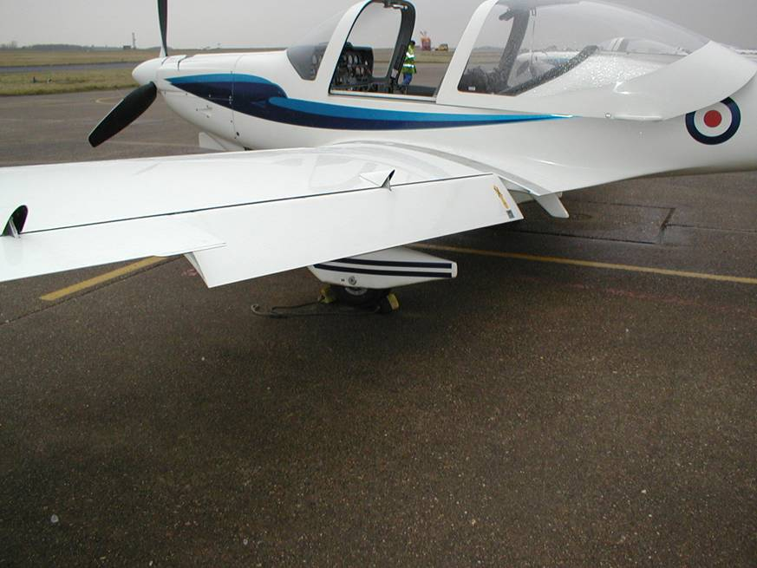

Slide 9
2. Split flap
60% increase C_{LMAX} Critical angle 14º

Slide 10
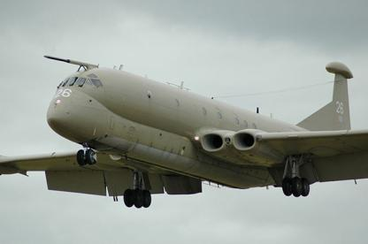
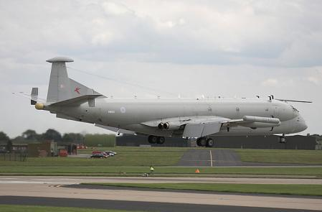
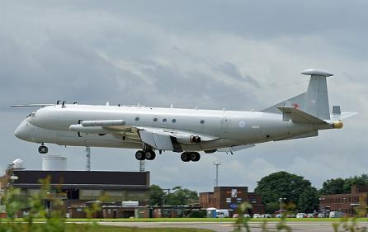
Nimrod
Split flap

Slide 11
3. Slotted flap
65%iIncrease C_{LMAX} Critical angle 16º

Slide 12
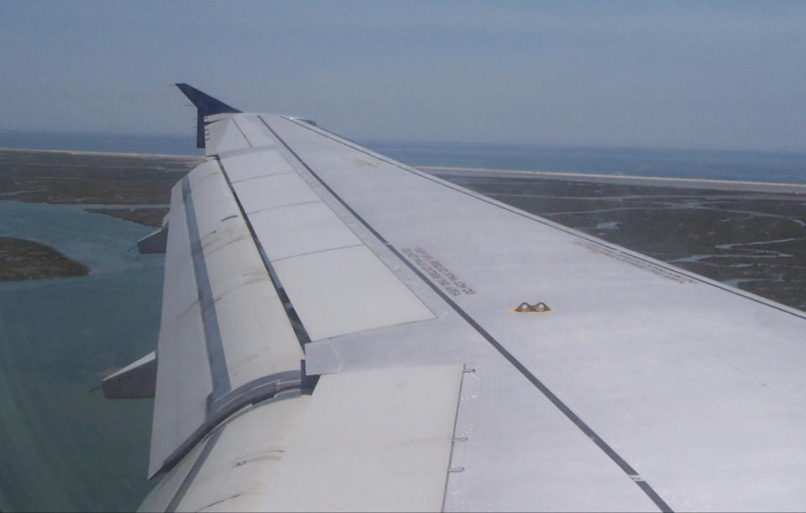

Slide 13
4. Blown flap
80% increase C_{LMAX} Critical angle 16º

Slide 14
5. Fowler flap
90% increase C_{LMAX} Critical angle 15º

Slide 15


Slide 16
6. Krueger flap
50% increase C_{LMAX} Critical angle 25º

Slide 17
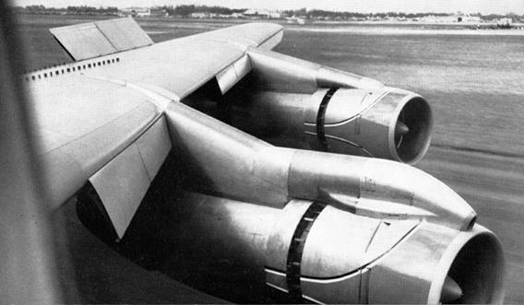

Slide 18
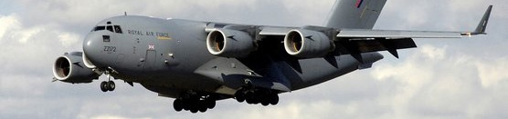
7. “Droop Snoot” flap
50% increase C_{LMAX} Critical angle 20º

Slide 19
Slats
Automatic slat
70% increase C_{LMAX} Critical angle 25º
Notes:
FIXED SLAT
Only works at high AOA ie t/o and landing
What is a slat?
Slats are another device which designers may fit to improve handling at low speeds. They are small aerofoils (i.e. shaped so as to develop lift), positioned along the leading edge of each wing. The diagram shows an automatic slat, which is designed so that when it is not needed it is held in the closed position by springs.
When the wing reaches a high angle of attack, the lift forces on the highly-cambered slat overcome the springs and the slat opens. Air can now flow through the slot formed between the slat and the wing. The shape of the slot is such that the air accelerates through it; this improves the pattern of the airflow over the wing, with some very beneficial effects. Instead of stalling at the usual angle of attack of 15° or so, the wing can reach an angle of as much as 25° before stalling, and the stalling speed is very much reduced.
For example, an aircraft whose stalling speed in approach conditions would be 100 kts without slats, might have it reduced to 80 kts with slats fitted. They do, however, cause extra drag which is unwanted at higher operating speeds, which is why they are designed so that the springs close them automatically at lower angles of attack. On some aircraft the slats are not automatic, but are operated from the cockpit in conjunction with the flaps, for use during takeoff and landing. To provide maximum lift, so as to take off in the shortest possible distance, the leading edge slats are opened fully, and the flaps are extended to about 20°.
When the aircraft is airborne, the slats and flaps are closed and the aircraft is trimmed for normal flight. To provide a steep approach path and slow speed when landing, both slat and flap are fully extended. In the illustration, the amount of flap has been increased to 30°, but this angle varies with different types of aircraft and may be as much as 80°.

Slide 20
2. Fixed slat
50% increase C_{LMAX} Critical angle 20º
Notes:
FIXED SLAT
Only works at high AOA ie t/o and landing

Slide 21
Slot
40% increase C_{LMAX} Critical angle 20º

Slide 22
Flaps
What about drag?
Flaps 30º
Flaps 90º
Flaps 60º
Flap
30º
60º
90º
Lift
Large increase
Small increase
No sig increase
Drag
Small increase
Large increase
V large increase
Notes:
For most flaps, there is a huge gain in lift when they are lowered to angles of 30° to 60°, and very little more at 60° to 90°. Drag, on the other hand, increases only moderately at small angles and greatly at large angles of depression.
Obviously, because of the greatly increased lift given at 30° of flap, the stalling speed is reduced and consequently it is possible to use slower, safer approach and landing speeds. However, because very little extra drag is being produced, the approach angle is scarcely affected.
If 90° of flap are selected however, this gives a tremendous increase in drag, which in turn means that the pilot must lower the nose considerably to maintain the approach speed - in other words, the pilot has a much steeper approach angle and therefore a better forward view. Advantages of the lower approach speed include a reduced touch-down speed and a shorter landing run. Finally, the use of a small amount of flap (about 15°) will also improve the lift at take-off speeds, with such a small penalty in drag, that for most aircraft types a shortened take-off run is possible.

Slide 23
Any questions?

Slide 24
Questions for you …..

Slide 25
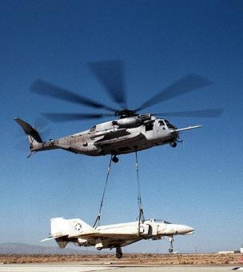
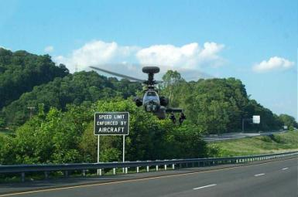
What effect does a trailing edge flap have on the stalling speed?
Higher
Lower
c. The same
d. No difference

Slide 26
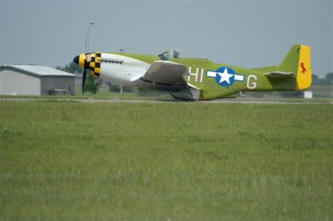
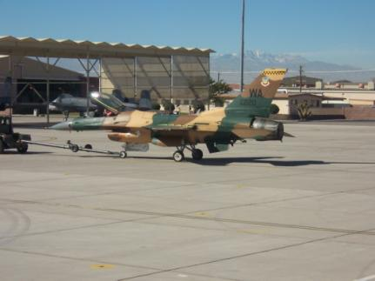
2. One type of leading edge flap is:
Plain
Slot
c. Split
d. Krueger

Slide 27
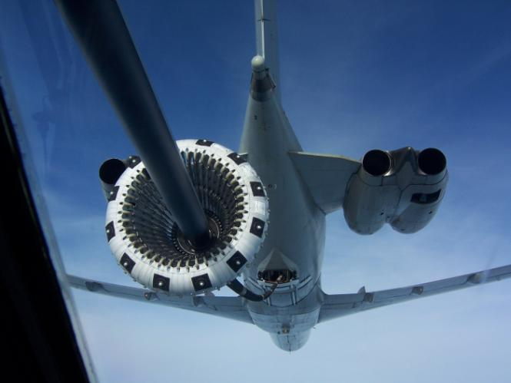
3. What are some of the high lift devices on the leading
edge called?
a. Plain flaps
b. Ailerons
c. Slats
d. Split flaps

